Slide 1
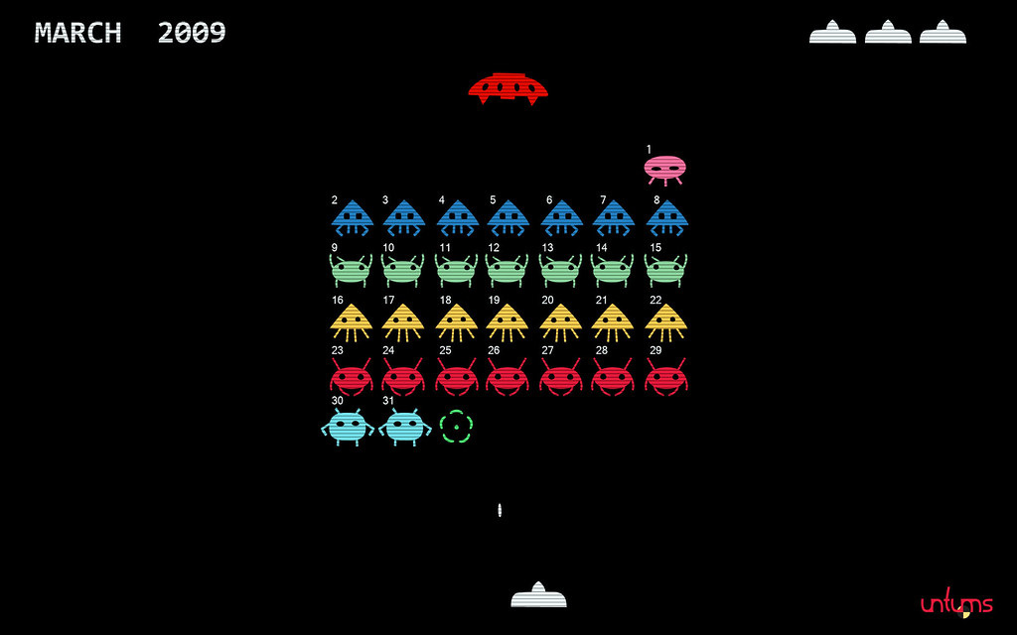
Collections of Objects
Learning Objectives
Using a collection
Collections of Objects
Filing cabinet – one object in each drawer
e.g. one instance of an invader in each drawer
invaderList
X:20
Y:50
X:50
Y:50
X:75
Y:50

Slide 2
Revision
class Invader
{
float x, y;
float speedX=5.0;
Invader(float x,float y) //constructor 2 args
{
this.x = x;
this.y = y;
}
Invader(float x,float y, float speed) //constructor 3 args
{
this.x = x;
this.y = y;
this.speedX = speed;
}
…
}
Invader invader1;
void setup() //event : program starts here
{
invader1=new Invader(50,30);
}
void draw() //event : code repeated 60 x sec
{
….
invader1 = null;
}
x
50
y
30
null
invader1
speedX
5.0
Declare instance var
new object – 2 arg constructor
Notes:
Class Invader : 3 members, multiple constructors – useful for future applications
Declare instance – value is null

Slide 3
Revision
class Invader
{
float x, y;
float speedX=5.0;
Invader(float x,float y) //constructor 2 args
{
this.x = x;
this.y = y;
}
Invader(float x,float y, float speed) //constructor 3 args
{
this.x = x;
this.y = y;
this.speedX = speed;
}
…
}
Invader invader1;
void setup() //event : program starts here
{
invader1=new Invader(50,30);
}
void draw() //event : code repeated 60 x sec
{
….
invader1 = null;
}
null
invader1
Remove object

Slide 4

Many objects
class Invader
{
float x, y;
float speedX=5.0;
Invader(float x,float y)
{
this.x = x;
this.y = y;
}
Invader(float x,float y, float speed)
{
this.x = x;
this.y = y;
this.speedX = speed;
}
…
}
Invader invader1, invader2, invader3, invader4 … invader50;
void setup() //event : program starts here
{
invader1=new Invader(50,30);
invader2=new Invader(60,30);
invader3=new Invader(70,30);
….
invader50=new Invader(50,30);
}
void draw() //event : code repeated 60 x sec
{
…
invader1.update();
invader2.update();
invader3.update();
…
invader50.update();
}
Create multiple objects
process multiple objects

Slide 5

Collections & Arrays
Dealing with multiple variables of same type - loop
2 options
Array of that type, e.g.
int [] arrayInts = new int[10];
Collection
ArrayList<InvaderClass> invaders;
Complex class
Each Collection is a class with
constructor(s) : empty collection
Methods to manage the collection
Grow or shrink as necessary
0
1
2
3..
invaderList
X:20
Y:50
X:50
Y:50
X:75
Y:50
0
invaderList
1
2
3
Notes:
Array is basic, we need to write our own code to manipulate and move things around is we remove something in the middle , also fixed size!

Slide 6
Collection
Java contains many different kinds of collection
ArrayList, common version
ArrayList is a class with built in methods, e.g.
add, remove, clear, size, get
ArrayList expands and shrinks as required
Starts off empty – when we create a new ArrayList
alienList
X: 50
Y: 50
dx = -2
…
X: 750
Y: 40
dx = -2
…
X: 230
Y: 35
dx = -4
…
X: 250
Y: 20
dx = -3
…

Slide 7
Declare and addItems
Import ArrayList from a Java library
import java.util.ArrayList;
ArrayList is a container class that stores a collection of objects of another class
Declare an object variable of type ArrayList< >
ArrayList<MyClass> listName;
Need to use new (in setup)
listName = new ArrayList<MyClass>(); //empty collection
Add our items – ArrayList<>.add(item) method
MyClass myInstance = new MyClass();
listName.add( myInstance ); //add myInstance at end of collection
< Class to store >

Slide 8
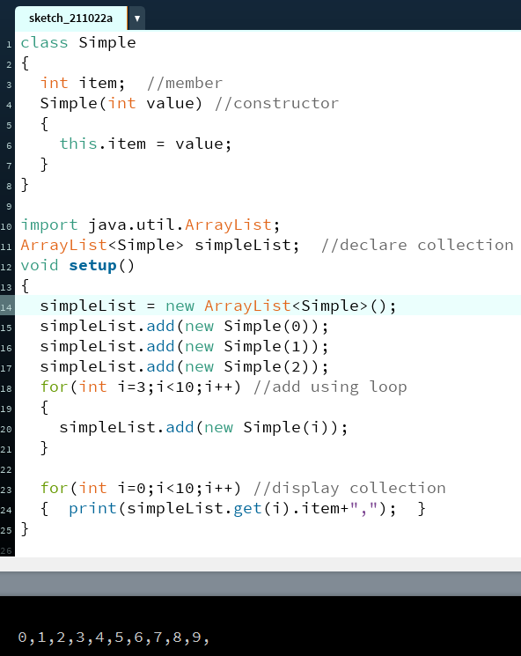
Example
Class to store in
Collection
Import from library
Declare ArrayList
New ArrayList (empty)
Add Objects to List
Loop(iterate) through
collection
Notes:
Add, separate commands or within a loop
Get – access contents of element number – each numbered drawer in filing cabinet

Slide 9
0
1
2
3
simpleList
Item: 0
Item: 1
Item: 2
Notes:
Line 14 creates the empty arrayList of class simple objects using NEW
15 : inner bracket – create a new simple object storing a 0, adds to drawer 0 of the arrayList
16,17 same as above, adds 1, then 2
18 : for loop adds more simple objects to next 7 elements of the arrayList

Slide 10
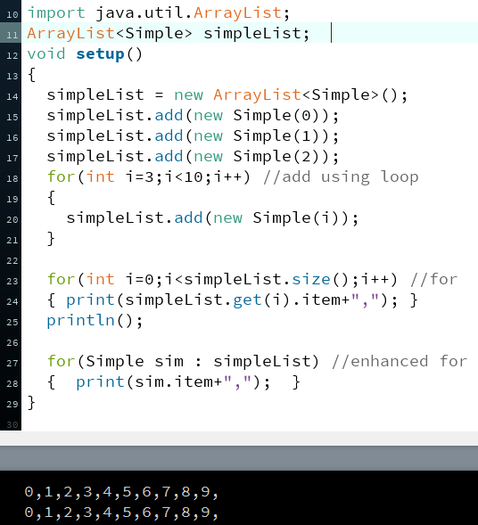
Collection Iteration
used with a for loop (counter), or
enhanced for loop
foreach element (in collection).
ArrayList<MyClass> list;
List stores objects of MyClass, so loop uses a MyClass variable
for (MyClass element : list)
Read as: foreach element in the ArrayList called list,
where element is a MyClass object
element will be the first object in the list, then the 2nd etc until all have been visited
Used to search or to perform an action on every member (e.g. render it, move it, or see if it’s collided)

Slide 11
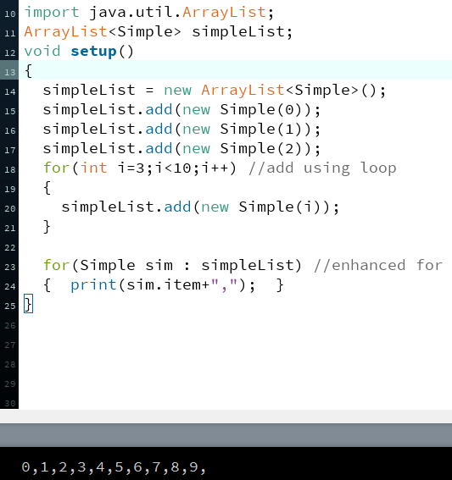
For each item : ArrayList
0
1
2
3
simpleList
Item: 0
Item: 1
Item:2
sim
sim
sim

Slide 12
Collection of objects
We can use ArrayList to manage a collection of our Invader class
Add many invader objects to the ArrayList
Iterate through the ArrayList to update each in turn (using for each)
Iterate through the list to determine if it’s collided, been shot, left the screen etc – it should be removed from the game
Can’t remove from a collection, inside a loop iterating through the collection
if (invader1.IsShot(bullet))
{
invader1=null;
bullet=null;
}
Invader shotInvader = null;
for (Invader alien : invaderList)
{
if (alien.IsShot( bullet ))
{
shotInvader=alien;
}
} //end for each
if ( shotInvader!=null )
{
invaderList.remove(shotInvader);
}
for (Invader alien : invaderList)
{
if (alien.IsShot( bullet ))
{
invaderList.remove(alien);
}
} //end for each

Slide 13
Removing from collection
0
1
2
3
bullet
X:52
Y:53
dY: -2
invaderList
X:20
Y:50
X:50
Y:50
X:75
Y:50
Invader shotInvader = null;
for (Invader alien : invaderList)
{
if (alien.IsShot( bullet ))
{
shotInvader=alien;
}
} //end for each
if ( shotInvader!=null )
{
invaderList.remove(shotInvader);
}
alien
alien
alien
shotInvader
0
1
2
3
invaderList
X:20
Y:50
X:75
Y:50
shotInvader

Slide 14
Collection : remove object
Using a standard for loop, remove inside loop is allowed
invaderList.size is called every time round the loop
for (int i=0;i<invaderList.size(); i++)
{
if (invaderList.get(i).IsShot( bullet ))
{
invaderList.remove(i);
}
}
for (Invader alien : invaderList)
{
if (alien.IsShot( bullet ))
{
shotInvader=alien;
}
} //end for each
if ( shotInvader!=null )
{
invaderList.remove(shotInvader);
}

Slide 15
Summary
ArrayList of objects : collection
Enhanced for loop - foreach, visit each object in collection
arrayList methods : add(item), remove(item) etc
Finding and removing an element - flag

